Slide 1
Team 5
Group members:
Chanip Chong
Parshwa Gandhi
Jacob Rodriguez

Slide 2
Agile
8 weeks
4 sprints
preparing the project
website design
implementation
testing

Slide 3
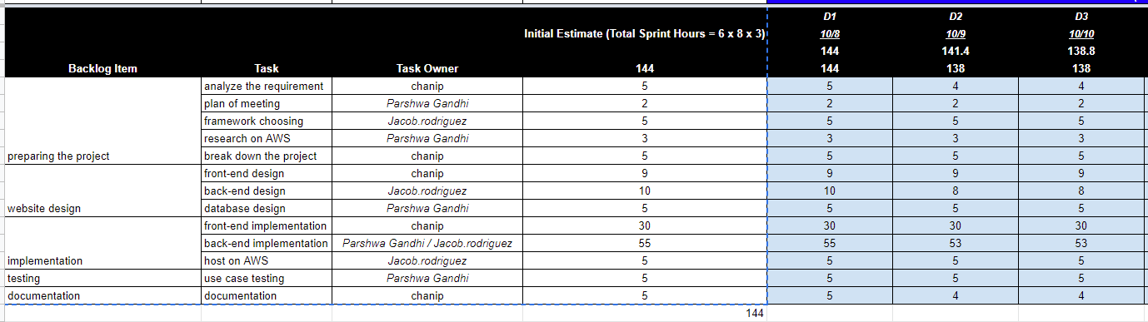
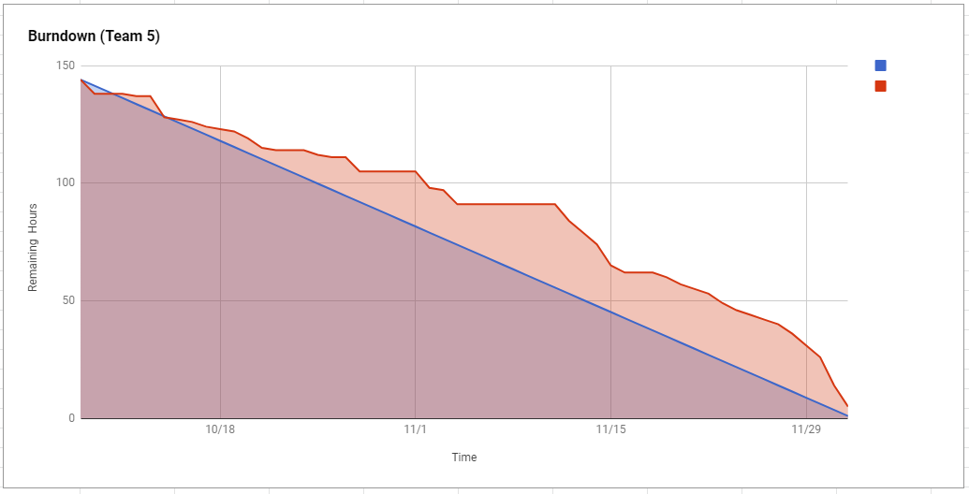
sprint task sheet & burndown chart

Slide 4
Contributions
Chanip:
Most of the Frontend creation
Documentation, diagrams, final report
System requirements workflow
Parshwa:
Database research and connector engine
Feature functionality (Email to Listing owner, Details of single Listing)
Documentation
Help with frontend
Jacob:
Django app creation
Setup of database
Feature functionality (New user, login auth, Post rental or home, Searching, Favorites, View offers, Admin site)
Deployment on AWS
Documentation

Slide 5
Tools
MongoDB as database
Django for backend
Bootstrap for frontend (css/ javascript)
AWS (server)
Slack (communication)
Zoom (Meetings)
Google drive (documentation share)
Github (version control)

Slide 6
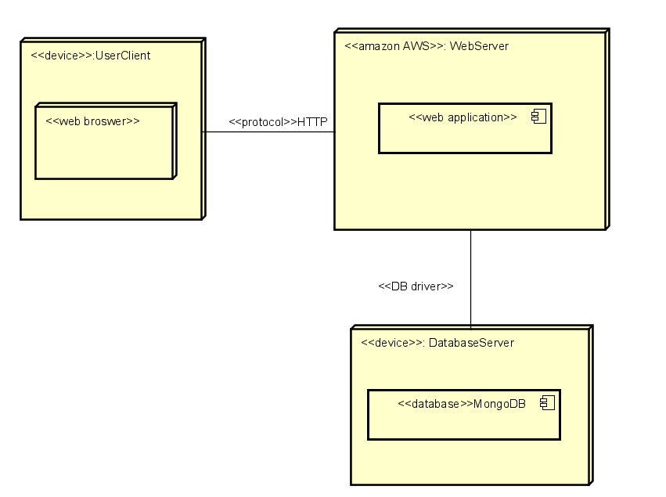
Architecture

Slide 7
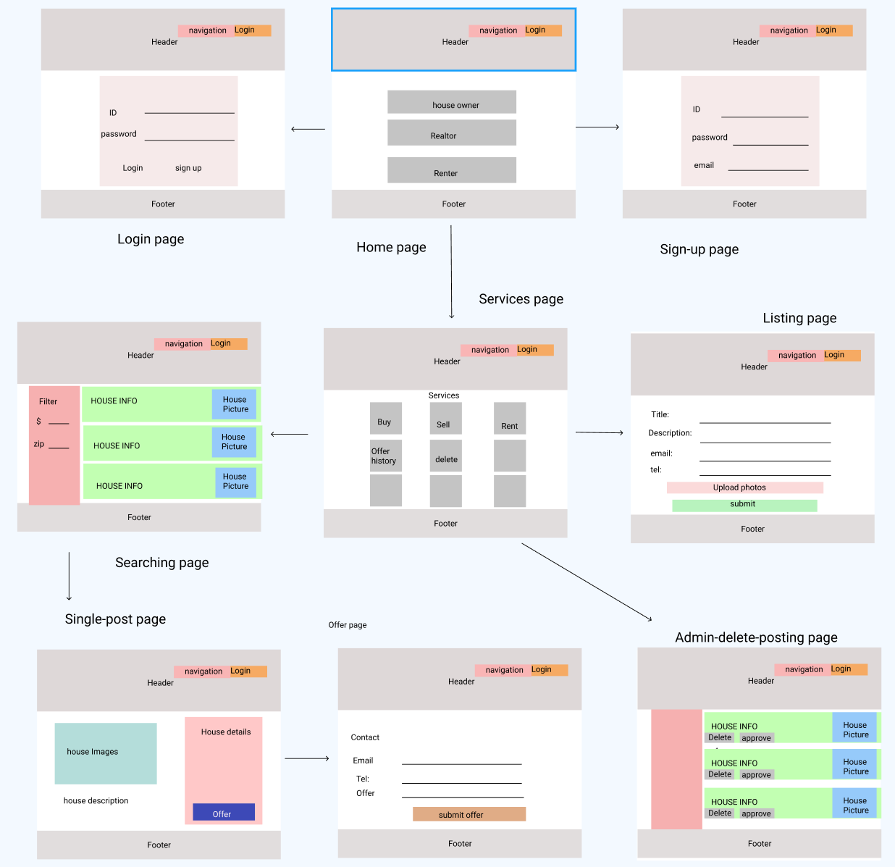
WireFrames

Slide 8
Demo

